Slide 1
Dynamic Sporadic Server (DSS)
Real-Time Scheduling for Aperiodic Tasks
A presentation by Moiz Zaheer Malik

Slide 2
Introduction
Why We Need DSS
Real-time systems have two types of tasks:
Periodic → predictable
Aperiodic → unpredictable
Problem: Serving aperiodic tasks without missing deadlines of periodic ones
DSS is one solution that handles this well under EDF scheduling
Reference: [1], [5]

Slide 3
Background – Key Terms
Periodic Task: Runs regularly (e.g. every 5 ms)
Aperiodic Task: Random arrival (e.g. button press)
EDF (Earliest Deadline First): Dynamic priority scheduling
Utilization: CPU load = execution time ÷ period
Reference: [1], [3]

Slide 4
Server-Based Scheduling
Use "servers" to handle aperiodic tasks
Types:
Polling Server
Deferrable Server
Sporadic Server (SS)
Dynamic Sporadic Server (DSS)
DSS = smarter, dynamic version of SS
Reference: [1], [4], [5]

Slide 5
How DSS Works (Simple View)
DSS has:
A budget (Cs)
A period (Ts)
When task arrives:
DSS sets a deadline
Runs the task using available budget
Only used budget gets refilled after Ts
Ensures: ✅ Aperiodic tasks served fast ✅ Periodic tasks don’t miss deadlines
Reference: [1], [5]

Slide 6

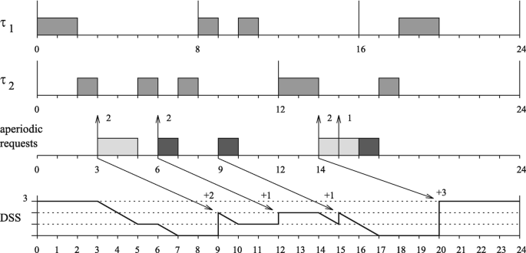
DSS Behavior (Step-by-Step)
Aperiodic task arrives
DSS assigns deadline = now + Ts
DSS executes it
Used budget gets refilled after Ts
Repeat
✅ Condition: Total CPU usage (Us + Up) must be ≤ 1
Reference: [1], [5]

Slide 7
Where DSS is Used (Applications)
Automotive ECUs
Avionics systems
Medical devices
Embedded Linux
Robotics & multimedia
Reference: [1], [2],[5]

Slide 8
Conclusion
DSS helps mix periodic + aperiodic tasks safely
Uses dynamic deadlines
Reuses only consumed budget
Achieves 100% CPU usage without missing deadlines
Ideal for modern real-time systems
Reference: [1], [5]

Slide 9
References
[1] G. C. Buttazzo, *Hard Real-Time Computing Systems*, Springer, 2011. https://www.academia.edu/31382579/Hard_Real_Time_Computing_Systems_1461406757B
[2] P. A. Laplante, *Real-Time Systems Design and Analysis*, Wiley-IEEE, 2011. chrome-extension://efaidnbmnnnibpcajpcglclefindmkaj/https://staff.emu.edu.tr/alexanderchefranov/Documents/CMSE443/CMSE443%20Spring2020/Laplante2012%20Real-Time%20Systems%20Design%20and%20Analysis.pdf
[3] C. L. Liu and J. W. Layland, “Scheduling algorithms for multiprogramming in a hard-real-time environment”, *JACM*, 1973. chrome-extension://efaidnbmnnnibpcajpcglclefindmkaj/https://dl.acm.org/doi/pdf/10.1145/321738.321743
[4] B. Sprunt et al., “Aperiodic Task Scheduling for Hard-Real-Time Systems”, *Real-Time Systems Journal*, 1989. Aperiodic Task Scheduling for Hard-Real-Time Systems
[5] M. Spuri and G. C. Buttazzo, “Efficient Aperiodic Service under Earliest Deadline Scheduling”, *RTSS*, 1994. https://ieeexplore.ieee.org/stamp/stamp.jsp?tp=&arnumber=342735

